Slide 1
How ACC can support your business
10 December 2021
Notes:
How we can support you.

Slide 2
What You Will Hear About
ACC Overview
From Case Management to Client Recovery
Return to Work / Recovery At Work
How Experience Rating Affects The Levy You Pay
The Benefits Of Accessing My ACC for Business
Useful Resources
Notes:
Intro to speaker.
Video next and will then provide ACC overview

Slide 4
ACC OVERVIEW

Slide 5
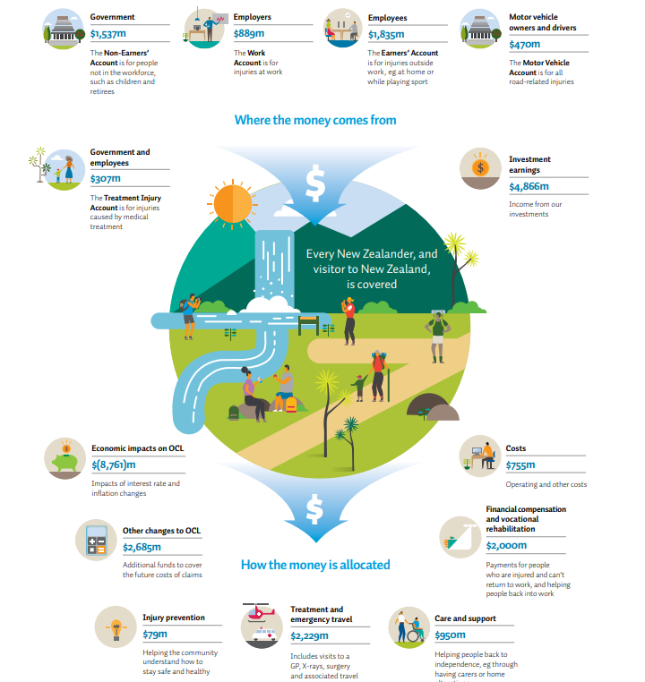
Notes:
Point to get across – ACC big organization that has responsibility to manage public funds.
We need to monitor and address any funding gap to avoid future generations paying for today’s injuries.
Cost to support injured people – expected to increase 4-6% over the next three years due to:
Volume of injuries & rehabilitation and treatment costs
Funding a lifetime of support - Approximately 18,000 people who received our support last year were injured over 30 years ago.

Slide 6
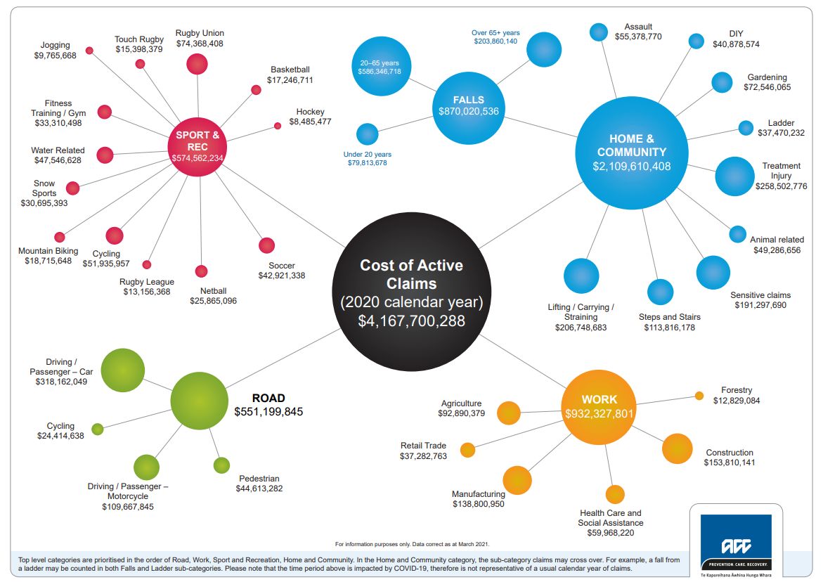
Notes:
2 million claims per year. Just over 100k weekly comp. 5%
Cost of active claims in 2020 – over $4 billion. Home & community over half of this. - Preventable campaign as seen on TV focus more on community related injuries. Have a hmmmmm
Work account - construction, Manufacturing, agriculture – are our big three.
Sport – Rugby union

Slide 7
Notes:
So how collected?
Focus predominantly on work account as audience business orientated.
Work account - 'risk based'. So higher industries (LRG in ACC talk) will be charged more in levies that less risked.
Q: in chat what you think is the most riskest industry and what is the rate we charge?
A: Professional Rugby, league, professional horse related – jockeys and stables - $6.43. Lowest 0.04 - accounting, IT services, legal
Earners – employees via PAYE, self employed – invoiced.
MVA – either at pump or via vehicle registration.

Slide 8
Proposed levy rates
Current average levy:
$0.67 per $100 payroll
Proposed:
$0.63 in 2022/23
$0.65 in 2023/24
$0.67 in 2024/25
...enough surplus funds to allow for a decrease in levy rate.
Current levy:
$1.21 per $100 wages
Proposed:
$1.27 in 2022/23 $1.33 in 2023/24 $1.39 in 2024/25
Current average levy:
$113.94 per vehicle
Proposed:
$120.20 in 2022/23
$128.83 in 2023/24
$138.08 in 2024/25
...not enough surplus funds to enable their levy rates to go down.
Notes:
We have just complete levy consultation – and above proposed rates we consulted on. Will be awaiting cabinet approval. May change. Work, earners come into effect 01/04/22. MV 01/07/22
These are the standard rates/ ER for larger employers or NCD for smaller employers would be applied on top/discount of dependiig on claims experience
When locked in, strongly suggest sharing with your company's finance team

Slide 9
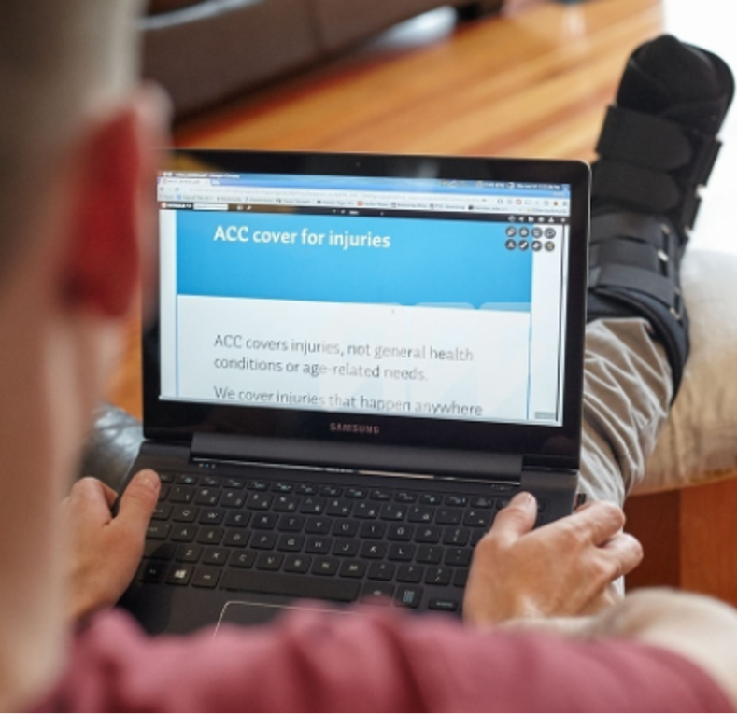
ACC - What We Do Cover
Covered​
​
​
Physical injury caused by accident
Work-related gradual process disease or infection
Treatment injury
Mental injury caused by;
Sexual abuse / sexual assault
Sudden traumatic event in the workplace
Physical injury
Notes:
Question: Do cover covid?
Cover for the COVID-19 virus may be available if you're diagnosed with the virus and you meet the criteria for a work-related gradual process, disease or infection under section 30 of the Accident Compensation Act 2001. Lodge via normal process via GP.
Physical injury resulting from a vaccination, including the COVID-19 vaccine, may be covered if the criteria for treatment injury are met. Under ACC legislation, the injury must be clearly caused by the vaccination and must not be a necessary part or ordinary consequence of the treatment.
For example, inflammation and pain around the site of the injection, flu like symptoms, fatigue are common with vaccinations (an ordinary consequence) and is unlikely to be covered. Infections (such as cellulitis or septic arthritis) due to the vaccination, and anaphylaxis resulting in injury are not ordinary consequences and are likely to be covered.
Side note: first National Strategy to Eliminate Family Violence and Sexual Violence launched this week. All of GOVT - ACC has major role.

Slide 10
ACC – What We Don’t Cover
Not covered​
Non-work gradual process injuries
Ageing process
Illness
Stress (unless related to sexual abuse, physical injury or traumatic event at work)
Injury to teeth arising from their natural use
Hernia caused by coughing or sneezing
Notes:
Stress – emphasize
Q: I would be interested to know how ACC determine work related stress and how they then determine cover.
Stress on its own is not covered. Unless related to sexual abuse, physical injury or traumatic . Work related mental injuries – but very high threshold and not ordinary consequences.

Slide 11
Case Management to Client Recovery

Slide 13
Entitlements
Weekly Compensation
Treatment – Physio, GP, Surgery
Social Rehabilitation – Home Help, Attendant Care, Personal Care, Transport
Vocational Rehabilitation – Stay at Work Programme, Workplace Assessments
Notes:
Most claims 90-95% dont require any active ACC involvement. Most dealt with GP/Physio only.
Where people off work longer than 7 days – weekly compensation. 80%. IRD provides earnigs details.
Treatment – GP, physio. IN back ground we pay approx $30 per appt. Surcharge is a bus decision by the provider. NOT ACC.
Social Rehabilitation – needs assessed. Could be 2 hours of home help per week through to house or car modifications.
Voc Rehabilitation – more complex situations only (off work for a longer period of time). Often will have an ACC CASE Owner involved

Slide 14
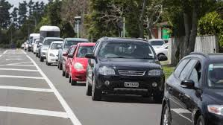
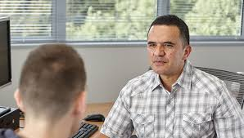
Case Management
PAST
Notes:
ACC only (not apply to AEP/TPA)
Face to Face predominantly in the branch network across NZ. Regional based.
Resource heavy.
Outdated systems, processes and programmes.
Case Management model essentially hadn't changed since 1974. Wasn't fit for purpose for present day

Slide 15
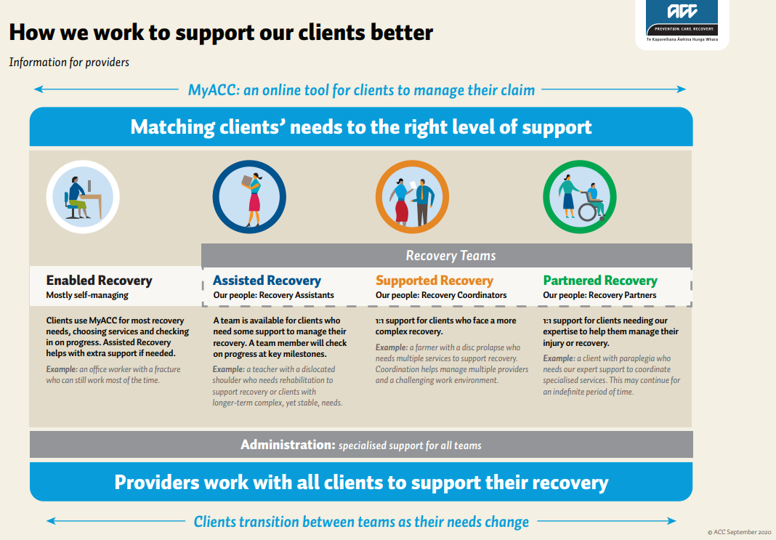
Notes:
ACC only (not apply to AEP/TPA)
Partnered – very seriously injured. 1:1 at local branch.
Supported – also 1:1. Services via the local branch. Very simalr to the old case mgt model.
Assisted: Team of recovery assistants. No allocation of claims to our staff I.e no portfolios. Task based work flow. 5 hubs across NZ. No regional based claim allocations. Calls in a re picked up by call centre and triaged. Complex quiers will be transferred to assisted team members. Proactive Welcome conversation to clients and most employers by assistesd staff. Regular check ins and significant milestones.
Enabled: Self managed by clients. With MYACC the key platform. Clients, employer can still call call centre.
If in assisted – we should be completing the welcome covo with employee and you as the employer and check ins and major milestones.
If in doubt – call 0800101 996.

Slide 16
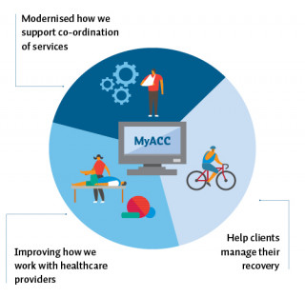
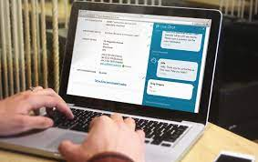
Client Recovery
FUTURE
Notes:
Self Management at the use of digital platforms.
MYACC:
Claim management
View and update personal information held in their profile
View and update details about their accident and diagnosis
View their timeline (progress on requests & and action the client needs to take)
View their ACC Recovery team member and contact details
Clients can provide authority to collect medical records & other information
Clients can accept their rights and responsibilities
Maintain notification preferences
Request a Pre-employment check (PEC) report
Weekly Compensation
Apply for Weekly Compensation
View information about past and upcoming payments
Update their bank account, tax code, and IRD number
Tell ACC how many hours they’ve worked (for Abatement)
View their Medical Certificate expiry date
Upload Medical Certificates
Other help
Chat Bot – for log in and registration support prior to logging in
Live Support – Support from Client Contact Centre for client questions after they log in
MYACC4B currently:
Update your contact and business details to get the correct invoice first time
Download your invoices
Check what you owe and pay by credit card, online payment or direct debit
See your work-related employee claims and costs covered by ACC
See subsidies your business is eligible for
View a timeline of your transaction history
Points looking to be included in MyACC for Business (under a role specific delegation for access) are:
Indicators that we are looking to include are (in priority order – first 3 appear through , others will hopefully be rolled out later)
Medical incapacity Date ranges – end/start date
Status: Fit for Selected/ Fully Unfit
If Fit for Selected work what are the restrictions on the med cert
Weekly Comp Days duration
DOFI (Date of First Incapacity) date
Stream - Enabled/Assisted/Support – for future click through direct email to the correct queue, where employers can add additional info to the team e.g. suitable duties, job description
Claim notification letter - live time generation through to MYACC4B from EOS

Slide 17
Benefits Of Accessing My ACC for Business

Slide 18
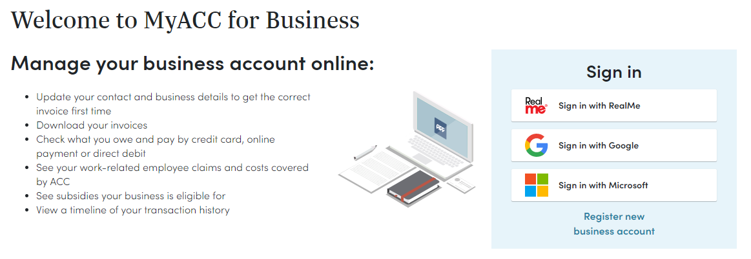
Notes:
MYACC4B currenlty:
Update your contact and business details to get the correct invoice first time
Download your invoices
Check what you owe and pay by credit card, online payment or direct debit
See your work-related employee claims and costs covered by ACC
See subsidies your business is eligible for
View a timeline of your transaction history
Points looking to be included in MyACC for Business (under a role specific delegation for access) are:
Indicators that we are looking to include are (in priority order):
Medical incapacity Date ranges – end/start date
Status: Fit for Selected/ Fully Unfit
If Fit for Selected work what are the restrictions on the med cert
Weekly Comp Days duration
DOFI (Date of First Incapacity) date
Stream - Enabled/Assisted/Support – for future click through direct email to the correct queue, where employers can add additional info to the team e.g. suitable duties, job description
Claim notification letter - live time generation through to MYACC4B from EOS
MYACC:
ACC automatically invites clients to register for MyACC when a client’s claim is assigned to a Recovery stream, and if:
the client or claim is not on the exclusions list
The client has a valid email address or mobile phone number
Claim management
View and update personal information held in their profile
View and update details about their accident and diagnosis
View their timeline (progress on requests & and action the client needs to take)
View their ACC Recovery team member and contact details
Clients can provide authority to collect medical records & other information
Clients can accept their rights and responsibilities
Maintain notification preferences
Request a Pre-employment check (PEC) report
Weekly Compensation
Apply for Weekly Compensation
View information about past and upcoming payments
Update their bank account, tax code, and IRD number
Tell ACC how many hours they’ve worked (for Abatement)
View their Medical Certificate expiry date
Upload Medical Certificates
Other help
Chat Bot – for log in and registration support prior to logging in
Live Support – Support from Client Contact Centre for client questions after they log in

Slide 19
Return to Work / Recovery At Work

Slide 20
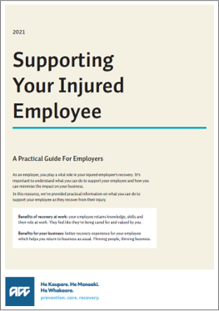
Return to Work – Guidelines
Notes:
Support employee back to work . TO work well need Employee, Employer and Provider working together. ACC always in background. But we need comms between, E, E, and P.
If complex – ACC to assist (we will be involved if streamed assisted, parted or supported). Much mor involvement in partnred and supporter compatred to assisted).
KEY: Communication
Key concepts. Not rocket science. And in our experience, everyone will have a much better R@W expereince.
EMPOWERING EMPLOYERS. COMMUNICATION is the key
1) Communicate absence to you as employer. If work accident, obligations to notify employer of accident. Start of conversation. Visited treatment provider? Med cert available.
2) maintain the open, regular communication. Check in. Set and agree how support their recovery at work
3) start conversation as early as you can. Talk positive – what tasks can do. Check med cert. Match with functional capabilities? Can do suitable duties? Modified?
4) Develop plan. Very simple and verbally agreed – such as agrre employee will call at end of week after physio appt. May need to talk to treatment provider?
5) continue to minotor progress. If FUF – can provide information the practioner - such as a list of duties and tasks to consider. If consent given, consider talking to physio, GP?
6) When returned, ensure have safely returned and can sustain job.
Refer to document here – has detail on the following:
FLow diagram – good 1 pager for line managers
Creating a Recovery at work plan
Medical certification – Stress the important of working with the provider. Nothing stopping the employer d. In fact, mor than likely the certification will be more balanced.
How to identify suitable duties
Important note. Due to privacy and confidential information, ACC is very limited in info we can share to any thirsd party including the employer. Need to ensure you continually talk to your injured employee at all times. Especially after appointments – whether physio, GP or SPct appointments – you will gather much more info that what acc can disclose to you.
Q:
I’m aware ACC cannot assist us with employment issues but is there any assistance that ACC can offer for longer tail claims to assist us plan manning. (more than 3 months).?
We Should have recovery plan (legislative all claims at 13 week must do). Which should include your involvment as the employer. Ask for it. Gain consent from your employee first. Much easier to plan rehab and RTW with consent.
At any time if complex or not going to plan – please contact ACC. We may be able to consider vocational rehab assistance such as a Stay at work (SAW) programme.
SAW:
Complex job and type of injury – more than what employer and employee can manage themselves
Concerns / flags raised regarding psychosocial factors (e.g. barriers such as workplace issues, previous claims history, reluctance, pain behaviours)
Needs professional assistance (as not being managed well by parties)
Who initiates the programme / requests it?
ACC or employer generally initiate the discussion, but employee must agree
Preferred provider can be requested by employer
Agreed plan is generally signed off by treating medical practitioner (e.g. GP or specialist)
Reduced hours and / or altered tasks
Modification of workplace environment (e.g. chairs, aids, voice activated software)
Address physical or psychological barriers if present (e.g. pain, fatigue, motivation)
Will develop a plan and build up gradually
May arrange treatment and travel
Comes with aggreed RTW plan – often signe doff my the GP or SPCT – as part of contract.
Q:
Employees advising after months of time off work that ACC will not be covering the claim and they will need to take sick leave to cover absence while they await public surgery.
ACC at times makes significant decisions on people claims - and these can not be dislosed to you as the employer – but may have significant impacts on wmployees weekly compensation (suspended). Imperative that you countian to liaise with employees.
Q:
Provision of a month to month fully unfit ACC certificate. Due to the short time frame it does not allow us to offer fixed term contracts to back fill the roles (admin and time it takes to train a person would outweigh value)
28 days is standard. Some time 6 weeks – between SPCT appointments. BUt we would argue that for sedentary to medium jobs – should be looking at FFSW earlier on in the piece. Again if serious injury, SPCT will be advising of time frames. Every surgery request, SPCT provdes RTW timeframes for light, medor heaver nature jobs. Need to liaise with employee or ACC. Gain idea of time frame – which should assist in your planning addiotnal labour units.

Slide 21
Experience Rating and Your Levy

Slide 22
Notes:
How to improve ER ; (n/a for AE's)
Re introduced around 10 years ago. Some changes have occurred over past few years. 75% discount. Up to 50% loading.
Simply like any insurance model, we want to reward customers with good behaviour – hence levy or premium discounts. So in the motor insurance world. If you have non fault accidents – you will get no claims discounts,
However if you have Mutiple claims with motor car insurance i.e having lots of accidents – you will lose your NCD, and maybe eben have a premium increase. ER work the same way. If you have more work claims than the average, or it takes longer to help your employee return to work (weekly comp day) compared to your industry average, then your we have a levy increase....
We call this your ER modifier. If its a discount, on average you are performing better than your industry peers. If loading, not performing as well.
Biggest weighting in the modifier isis the w/c days – as it has the biggest financial impact on the scheme.
Applied to your standard levy rate.......
So how can you improve. Simply have great RTW policies and process in place. Work with your employee and provider. Where required contact ACC.

Slide 23
Useful Resources

Slide 24
USEFUL RESOURCES / LINKS
SUPPORTING YOUR EMPLOYEES RECOVERY AT WORK Visit our website
UNDERSTANDING YOUR INVOICE
If your have received an invoice from us and your are not sure what it all means, check out the levy invoice page on our website
MANAGE YOUR ACCOUNT ONLINE
Log into MyACC for Business – here you can:
Update your contact and business details
View your most recent invoice – check your experience rating results
Download your invoices
Check what you owe and make a payment
See your-related employee claims and any costs covered by us
HOW EXPERIENCE RATING WORKS
If you would like more information on how experience rating works, check out our Welcome to Experience Rating page on our website
WORKPLACE HEALTH & SAFETY
If your would like to learn more about what we are doing to help businesses visit our website
COVID-19
If you want to know more about our approach and some FAQ’s, check out our ACC information about COVID-19
LEVY CONSULTATION 2021
If you want to know about Cabinets final decisions then take a look here LevyResults
GENERAL BUSINESS QUERIES
Visit our website
Notes:
Link required.

Slide 25
CONTACT ACC
General business queries call 0800 222 776 or business@acc.co.nz
Claims queries call 0800 101 996 or claims@acc.co.nz
If your business has a Solutions Partner contact them directly or email us at BCS@acc.co.nz for escalation
More information on our website acc.co.nz – contact us

Slide 26
Questions

